Slide 1
Capstone Project
An automobile company wants to enter the Indian used-car market, they wants to understand the factors affecting the pricing of car in the market. They want to know which variables are significant in predicting the price of used car.
To do:
Perform the exploratory analysis, some basic descriptive statistics, manipulation. Followed by performing relevant hypothesis testing and model building and evaluate the result.

Slide 2
Which brand are selling most?

Slide 3
Are there specific locations selling more?

Slide 4
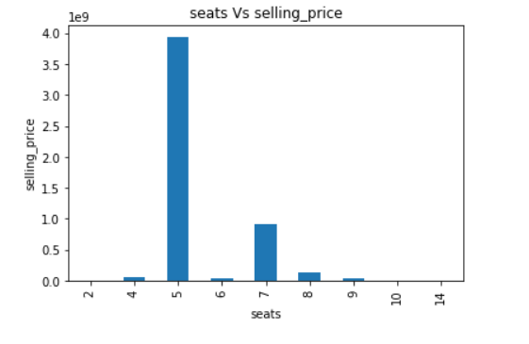
Effects of seats in the cars on selling price
5 seater cars have more selling price followed by 7 seater cars.

Slide 5
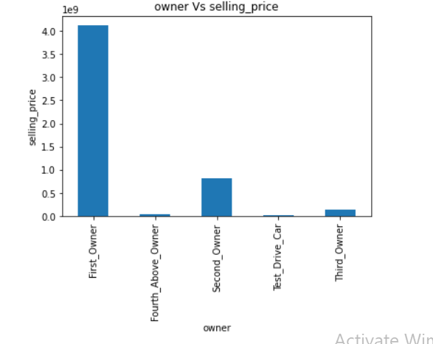
Effect of owner type on selling price
First owner type cars have high selling price in comparison to others.

Slide 6
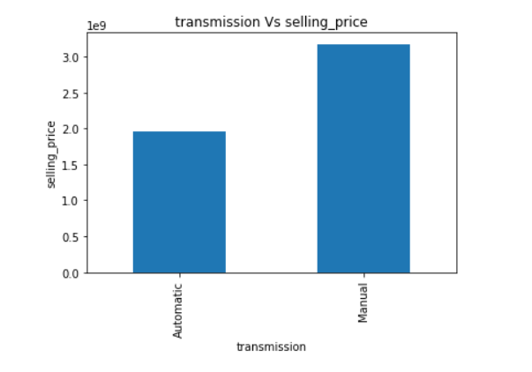
Relation between transmission and selling price of the car
Manual cars are more costlier than automatic ones.

Slide 7
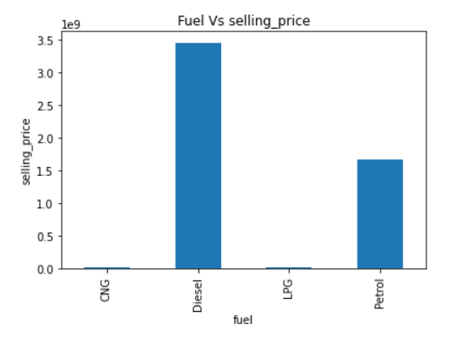
Fuel type effect on selling price
Diesel and Petrol cars have higher selling price as compared to LPG & CNG

Slide 8
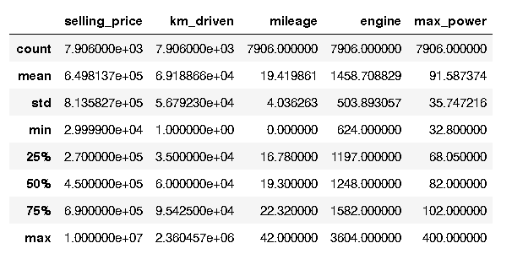
Descriptive statistics
For numeric data:

Slide 9
Descriptive Statistics
For categorical data:
Regional distribution Sold
Region Central 2376
Region East 1939
Region South 1615
Region West 1976

Slide 10
Descriptive Statistics
For categorical data
Fuel type Number of cars
Diesel 4299
CNG 52
LPG 35
Petrol 3520

Slide 11
Descriptive Statistics
For categorical data
Number of seats Number of cars
Seat 2 2
Seat 4 133
Seat 5 1652
Seat 6 62
Seat 7 1120
Seat 8 235
Seat 9 80
Seat 10 19
Seat 14 1

Slide 12
Which variables are significant in the predicting the price of a used car?
The significant variables are:
km_driven
Fuel
Brand
Seats
Owner type
Transmission
Mileage
Engine
Max_power

Slide 13
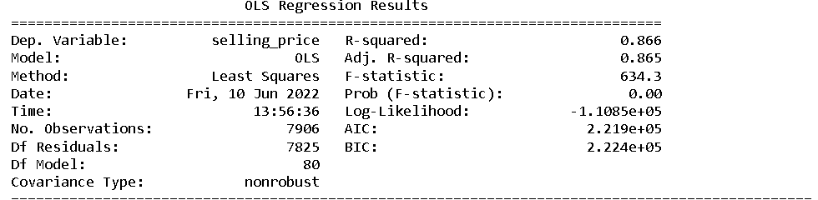
How well these significant variables describe the price of the car?
After running regression including all the dummy variables the Adjusted R square is 0.865.
So the variables significantly predict the selling price of car, with minimal error.

Slide 14
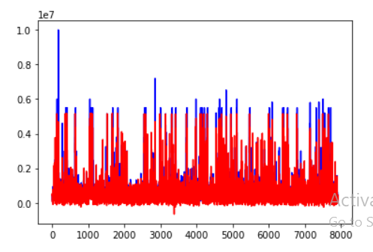
Model of predicted value and actual value of selling price of the cars.
Blue for actual Red for Predictions
Regression model is well
Enough able to predict the selling price, with some outliers.

Slide 15
Model Building
Three models used:
Logistic Regression
Random Forest Classifier
SVC
Push the data to Voting Classifier the estimator including the above models we got the estimator values.
Logistic Regression:0.86
Random Forest Classifier: 0.89
SVC:0.89
Voting Classifier: 0.912

Slide 16
Insights on the basis of models used:
All the estimators are significantly good in predicting the selling price of car(target variable).
Out of three classification models, Random Forest is the best estimator.

